Slide 1
ژورنال كلاب گوارش
دكترقويدل
دكترروحاني
8/4/96

Slide 2
ACG Clinical Guideline: Treatment of Helicobacter pylori Infection
CLINICAL GUIDELINES
Am J Gastroenterol 2017; 112:212–238; doi: 10.1038/ajg.2016.563 ; published online 10 January 2017

Slide 3
QUESTION 1:
WHAT IS KNOWN ABOUT THE
EPIDEMIOLOGY OF H. PYLORI INFECTION IN NORTH AMERICA?
WHICH ARE THE HIGH-RISK GROUPS?

Slide 4
Recommendation
H. pylori infection is chronic and is usually acquired in childhood.
The incidence and prevalence of H. pylori infection are generally higher among people born outside North America
Within North America, the prevalence of the infection is higher in certain racial and ethnic groups, the socially disadvantaged, and people who have immigrated to
North America

Slide 5
QUESTION 2:
WHAT ARE THE INDICATIONS TO TEST
FOR, AND TO TREAT, H. PYLORI INFECTION?

Slide 6
Recommendations
Since all patients with a positive test of active infection with H. pylori should be offered treatment, the critical issue is which patients should be tested for the infection
(strong recommendation, quality of evidence: not applicable)

Slide 7
All patients with active PUD, a past history of PUD (unless previous cure of H. pylori infection has been documented), low-grade MALT lymphoma, or a history of endoscopic resection of early gastric cancer (EGC) should be tested for H. pylori infection. Those who test positive should be offered treatment for the infection
(strong recommendation, quality of evidence: high for active or history of PUD, low for MALT
lymphoma, low for history of endoscopic resection of EGC)

Slide 8
In patients with uninvestigated dyspepsia who are under the age of 60 years and without alarm features, non-endoscopic testing for H. pylori infection is a consideration. Those who test positive should be offered eradication therapy
(conditional recommendation, quality of evidence: high for effi cacy, low for
the age threshold).

Slide 9
When upper endoscopy is undertaken in patients with dyspepsia, gastric biopsies should be taken to evaluate for H. pylori infection. Infected patients should be offered eradication therapy
(Strong recommendation, high quality of evidence).

Slide 10
Patients with typical symptoms of GERD who do not have a history of PUD need not be tested for H. pylori infection. However, for those who are tested and found to be infected, treatment should be offered, acknowledging that effects on GERD symptoms are unpredictable
(strong recommendation, high quality of evidence).

Slide 11
In patients taking long-term low-dose aspirin, testing for H. pylori infection could be considered to reduce the risk of ulcer bleeding. Those who test positive should be offered eradication therapy
(conditional recommendation, moderate quality of evidence)

Slide 12
Patients initiating chronic treatment with NSAID should be tested for H. pylori
infection
(strong recommendation, moderate quality of evidence).

Slide 13
Those who test positive should be offered eradication therapy. The benefits of testing and treating H. pylori in patients already taking NSAIDs remains unclear
(conditional recommendation, low quality of evidence)

Slide 14
Patients with unexplained iron defi ciency (ID) anemia despite an appropriate evaluation should be tested for H. pylori infection. Those who test positive should be offered eradication therapy
(conditional recommendation, high quality of evidence)

Slide 15
Adults with ITP should be tested for H. pylori infection. Those who test positive should be offered eradication therapy
(conditional recommendation, very low quality of evidence)

Slide 16
There is insufficient evidence to support routine testing and treating of H. pylori in asymptomatic individuals with a family history of gastric cancer or patients with lymphocytic gastritis, hyperplastic gastric polyps and hyperemesis gravidarum
(no recommendation, very low quality of evidence)

Slide 17
QUESTION 3:
WHAT ARE EVIDENCE-BASED
FIRST-LINE TREATMENT STRATEGIES FOR
PROVIDERS IN NORTH AMERICA?

Slide 18
Recommendations
Patients should be asked about any previous antibiotic exposure(s) and this information should be taken into consideration when choosing an H. pylori treatment regimen
(conditional recommendation, moderate quality of evidence).

Slide 19
Clarithromycin triple therapy consisting of a PPI, clarithromycin, and amoxicillin or metronidazole for 14 days remains a recommended treatment option in regions where H. pylori clarithromycin resistance is known to be <15% and in patients with no previous history of macrolide exposure for any reason
(conditional recommendation, low quality of evidence (for duration: moderate quality of evidence)).

Slide 20
Bismuth quadruple therapy consisting of a PPI, bismuth, tetracycline, and a nitroimidazole for 10–14 days is a recommended first-line treatment option. Bismuth quadruple therapy is particularly attractive in patients with any previous macrolide exposure or who are allergic to penicillin
(strong recommendation, Low quality of evidence).

Slide 21
Concomitant therapy consisting of a PPI, clarithromycin,amoxicillin and a nitroimidazole for 10–14 days is a recommended first-line treatment option
(Strong recommendation, low quality of evidence (for duration: very low quality of evidence)).

Slide 22
Sequential therapy consisting of a PPI and amoxicillin for 5–7 days followed by a PPI, clarithromycin, and a nitroimidazole for 5–7 days is a suggested first-line treatment option
(conditional recommendation, low quality of evidence (for duration: very low quality of evidence).

Slide 23
Hybrid therapy consisting of a PPI and amoxicillin for 7 days followed by a PPI, amoxicillin, clarithromycin and a nitroimidazole for 7 days is a suggested first-line treatment option
(conditional recommendation, low quality of evidence (For duration: very low quality of evidence)).

Slide 24
Levofloxacin triple therapy consisting of a PPI, levofloxacin, and amoxicillin for 10–14 days is a suggested first-line treatment option
(conditional recommendation, low quality of evidence (for duration: very low quality of evidence)).

Slide 25
Fluoroquinolone sequential therapy consisting of a PPI and amoxicillin for 5–7 days followed by a PPI, fluoroquinolone, and nitroimidazole for 5–7 days is a suggested first-line treatment Option
(conditional recommendation, low quality of evidence (For duration: very low quality of evidence)).

Slide 26
QUESTION 4:
WHAT FACTORS PREDICT SUCCESSFUL
ERADICATION WHEN TREATING H. PYLORI
INFECTION?

Slide 27
Recommendation
The main determinants of successful H. pylori eradication are the choice of regimen, the patient’s adherence to a multi-drug regimen with frequent side-effects, and the sensitivity of the H. pylori strain to the combination of antibiotics administered
(Factual statement, moderate quality of evidence).

Slide 28
QUESTION 5:
WHAT DO WE KNOW ABOUT H. PYLORI
ANTIMICROBIAL RESISTANCE IN THE NORTH
AMERICA?

Slide 29
Recommendation
Data regarding antibiotic resistance among H. pylori strains from North America remain scarce. Organized efforts are needed to document local, regional and national patterns of resistance in order to guide the appropriate selection of H. pylori therapy
(strong recommendation; low quality of evidence).

Slide 30
QUESTION 6:
WHAT METHODS CAN BE USED TO
EVALUATE FOR H. PYLORI ANTIBIOTIC RESISTANCE
AND WHEN SHOULD TESTING BE PERFORMED?

Slide 31
Recommendation
Although H. pylori antimicrobial resistance can be determined by culture and/or molecular testing
(strong recommendation; moderate quality of evidence), these tests are currently not widely available in the United States.

Slide 32
QUESTION 7:
SHOULD WE TEST FOR TREATMENT
SUCCESS AFTER H. PYLORI ERADICATION THERAPY?

Slide 33
Recommendation
Whenever H. pylori infection is identified and treated, testing to prove eradication should be performed using a urea breath test, fecal antigen test or biopsy-based testing at least 4 weeks after the completion of antibiotic therapy and after PPI therapy has been withheld for 1–2 weeks
(strong recommendation; low quality of evidence (for the choice of methods to test for eradication: moderate quality of evidence).

Slide 34
QUESTION 8:
WHEN PRIMARY THERAPY FAILS,
WHAT ARE THE OPTIONS FOR SALVAGE THERAPY?

Slide 35
Recommendations
In patients with persistent H. pylori infection, every eff ort should be made to avoid antibiotics that have been previously taken by the patient
(unchanged from previous ACG guideline ( 26 )).
(strong recommendation, moderate quality of evidence).

Slide 36
Bismuth quadruple therapy or levofloxacin salvage regimens are the preferred treatment options if a patient received a first-line treatment containing clarithromycin. Selection of the best salvage regimen should be directed by local antimicrobial resistance data and the patient’s previous exposure to antibiotics
(conditional recommendation; for quality of evidence see individual statements below).

Slide 37
Clarithromycin- or levofloxacin-containing salvage regimens are the preferred treatment options if a patient received first-line bismuth quadruple therapy. Selection of the best salvage regimen should be directed by local antimicrobial resistance data and the patient’s previous exposure to antibiotics
(conditional recommendation; for quality of evidence see individual statements below).

Slide 38
The following regimens can be considered for use as salvage treatment: Bismuth quadruple therapy for 14 days is a recommended salvage regimen
(strong recommendation, low quality of evidence).

Slide 39
Levofloxacin triple regimen for 14 days is a recommended salvage regimen
(strong recommendation, moderate quality of evidence (for duration: low quality of evidence)).

Slide 40
Concomitant therapy for 10–14 days is a suggested salvage regimen
(conditional recommendation, very low quality of evidence).

Slide 41
Clarithromycin triple therapy should be avoided as a salvage regimen
(conditional recommendation, low quality of evidence).

Slide 42
Rifabutin triple regimen consisting of a PPI, amoxicillin, and rifabutin for 10 days is a suggested salvage regimen
(conditional recommendation, moderate quality of evidence (For duration: very low quality of evidence)).

Slide 43
High-dose dual therapy consisting of a PPI and amoxicillin for 14 days is a suggested salvage regimen
(conditional recommendation, low quality of evidence (for duration: very low quality of evidence)).

Slide 44
QUESTION 9:
WHEN SHOULD PENICILLIN ALLERGY
TESTING BE CONSIDERED IN PATIENTS WITH H.
PYLORI INFECTION?

Slide 45
Recommendation
Most patients with a history of penicillin allergy do not have true penicillin hypersensitivity. After failure of first-line therapy, such patients should be considered for referral for allergy testing since the vast majority can ultimately be safely given amoxicillincontaining salvage regimens
(strong recommendation; low quality of evidence).

Slide 46
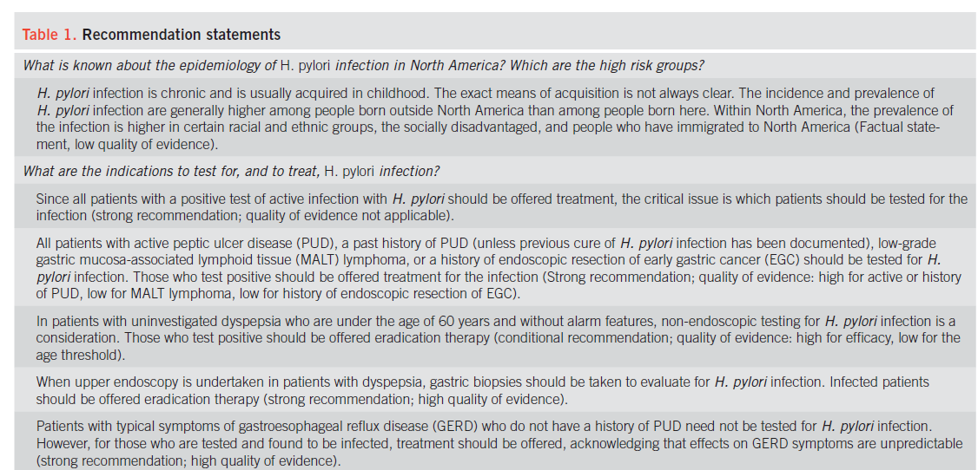

Slide 47
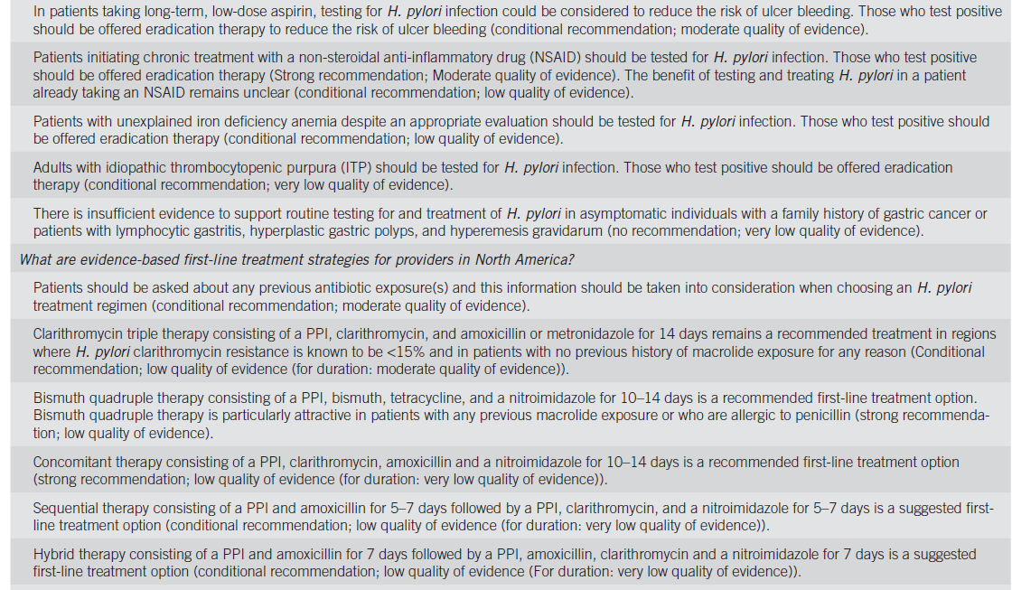

Slide 49
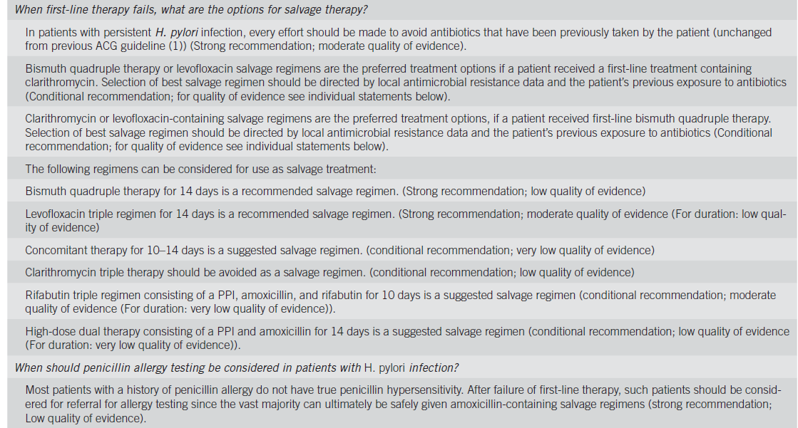

Slide 50
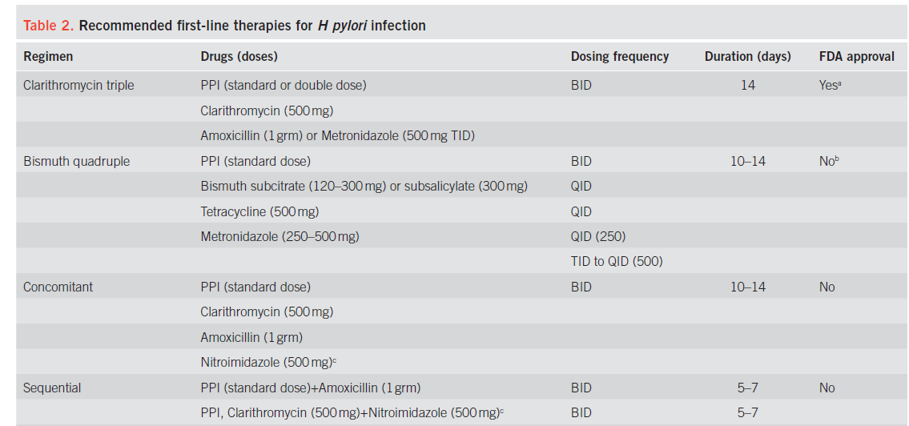

Slide 51
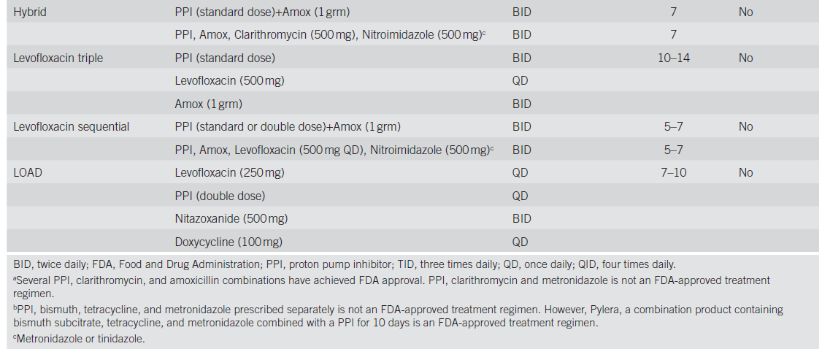

Slide 52
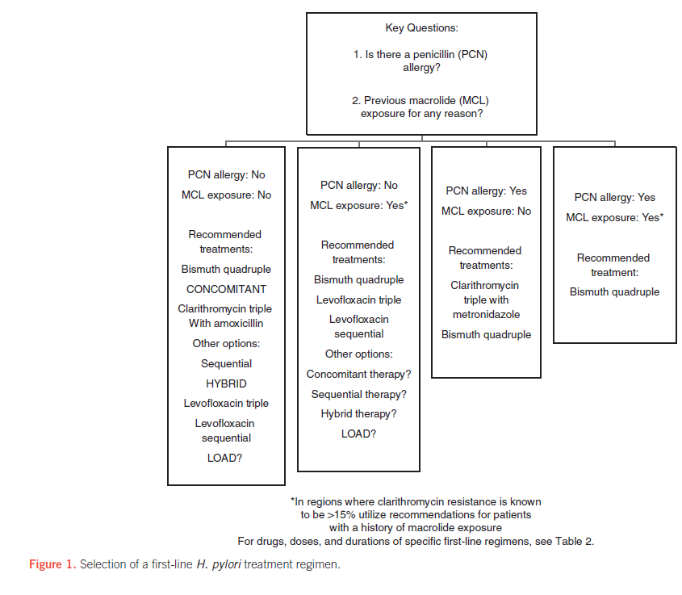

Slide 53
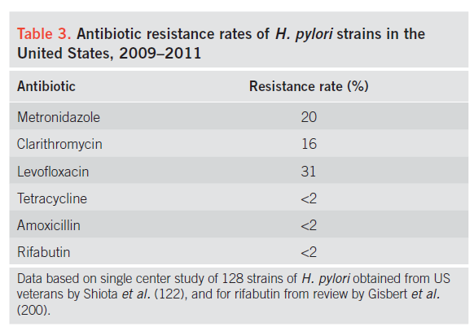

Slide 54
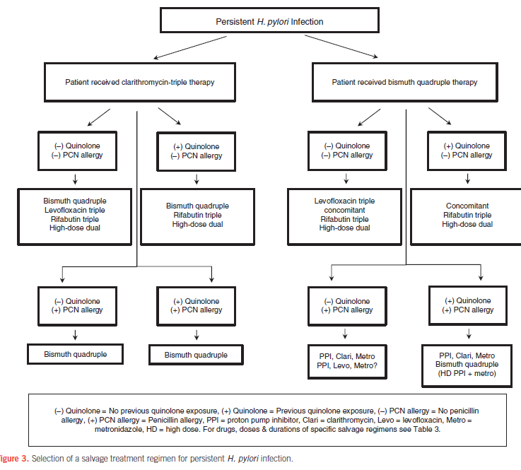

Slide 55
